Slide 1
Issues in Adapting Active Learning Strategies
Linda Hagan, Ph.D. – Walsh College
Elizabeth Durham Smith, M.A., Ph.D. Candidate – Wayne State
Julie Borkin, Ph.D. – Oakland University

Slide 2
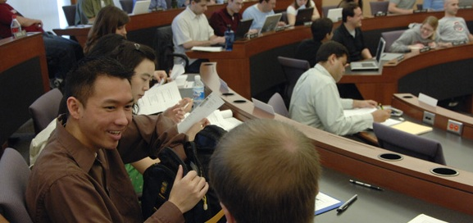
Active Learning Strategies
Why active learning?
How adapt to diverse learners?

Slide 3
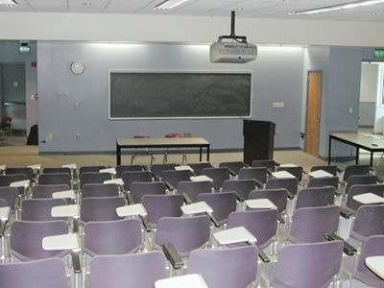
Adapting to Diverse Learners
Nontraditional students
Critical thinking in intro level courses
Active online learning

Slide 4
Nontraditional Students
Linda Hagan, Ph.D.
Walsh College

Slide 5
Who is the Non-Traditional Learner?

Slide 6
Today’s College Students?
“Typical”
Enter college straight out of high school
17 - 22 years old
Full time
Live on/near campus
Graduate in 4 years
Yesteryear’s student
Non-Traditional
Work for a few years before starting college
Older adults
Part time, but full-time job & family roles
Drive in just for class
Years to complete degree
Today’s student

Slide 7
Non-Traditional Learner Profile
Generally,
More motivated (financially & psychologically)
Deliver higher quality work
Study skills limited
Expect programs that are flexible
Want class time spent wisely
Need to be engaged

Slide 8
Active Learning
Goal: Engage mental & physical energies to make material meaningful for learning to occur
Challenge: How do you do that?

Slide 9
Strategies for Active Learning
Physical & Mental Activities
Case methods
Discussions
Debates
Peer “teaching” & critique
Problem solving exercises – team based
Use technology

Slide 10
Establish Meaningful Objectives
Students need to see link between knowledge acquisition & practical application
Not just what they need to know but why and how to apply it today
i.e., Acquire practical skills to make verbal presentations necessary for relationship building with an organization’s key publics.

Slide 11
“The sage on the stage or the guide by the side”
(Bosworth & Hamilton, 1996)

Slide 12
Critical Thinking in Intro Courses
Elizabeth Durham Smith, M.A., Ph.D. Candidate - Wayne State University

Slide 13
Critical thinking in Intro Courses
How might an introductory course go beyond the ‘obligatory’ nature of its required basic content?
How are active learning strategies employed with a diverse student body?

Slide 14
Wayne: A Profile in Diversity
Large international population - 10%
65% female, 35% male
Vast differentials in demographic make-up

Slide 15
Incorporating Critical Thinking
Goal: Employment of active learning strategies to cultivate/promote three components
Engagement
Meaningfulness
Responsibility
Challenge: Tapping into the potential that a vastly diverse student body offers

Slide 16
Strategies
Role of media literacy
Tactical and mindful
Films, television shows, youtube clips
Example:

Slide 17
Active Online Learning
Julie Borkin, Ph.D.
Oakland University

Slide 18
Active Online Learning
Who are the online students?
Expecting the unexpected
No succinct profile

Slide 19
Active Online Learning
Goal: Foster a context of vitality and engagement despite diversity, distance, asynchronic factors
Challenge: How do you do that?

Slide 20
Challenging Active Learning Norms
Usually thought of in the application (post presentation) stage
Usually prescribed for face to face – “eavesdropping” and immediate debrief

Slide 21
Online Strategies
Begin with the course development
Require clarity and repetition
Open new sites for collaboration

Slide 22
Online Strategies
Survey (pre-presentation)
Discussion Boards – threads
Wiki (case study) – 2 phases
Personal Journal – 3 questions

Slide 24
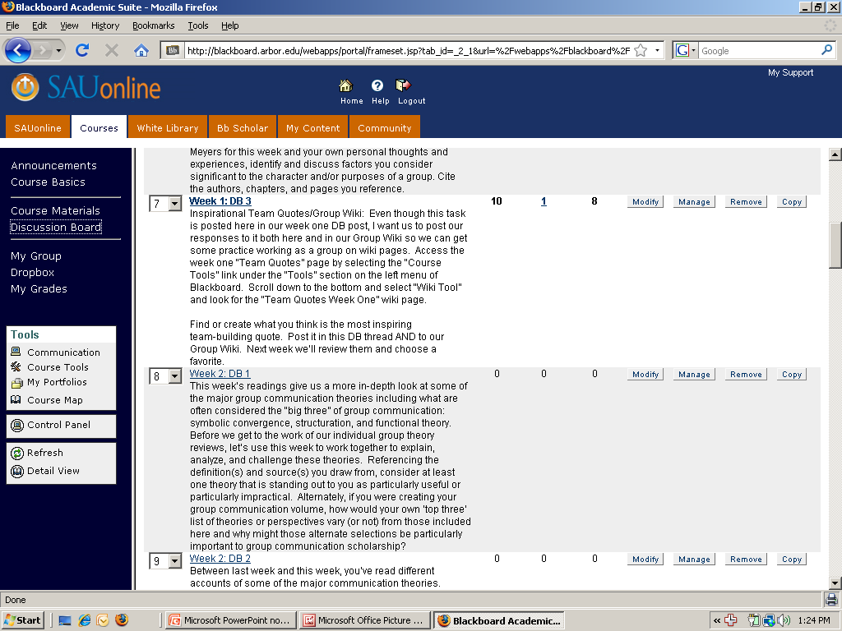

Slide 25
References
Benshoff, J. M., & Lewis, H. A. (1992, December). Nontraditional college students. Retrieved May 1, 2009, from ERIC Digest.
Bosworth, K., & Hamilton, S. (1994). Collaborative Learning: Underling Process and Effective Techniques. San Francisco, CA: Jossey-Bass Publishing.
Center for Urban Studies. Retrieved May 7, 2009 from www.cus.wayne.edu/census/censusindex.asp
Grabinger, R. S. & Dunlap, J. C. (1995). Rich environments for active learning: A definition. Alt-J. 5-17.
Harris, P., & Johnson, R. (2006). Active learning: Non-traditional teaching and learning strategies. Retrieved May 1, 2009, from http://www.montana.edu/teachlearn/Papers/activelearn2.html.
King, A. (1992). Sage on the stage to guide on the side. College Teaching, 41(1), 30-35.
Nellen, A. (2003, May). Using technology to teach nontraditional students. The Tax Advisor, 34(5), 290-293.
Noujaim, J. (2004). Control Room [motion picture]. Magnolia Pictures. Santa Monica, CA: Lionsgate Home Entertainment.
U.S. Department of State. (2008, April 29). Nontraditional students enrich U.S. college campuses: Older students value challenging courses for real-world applications. Retrieved May 1, 2009, from http://www.america.gov

